Slide 1
ORGANISATION & MANAGEMENT OF MRD
DEBJANI MUKHERJEE

Slide 2
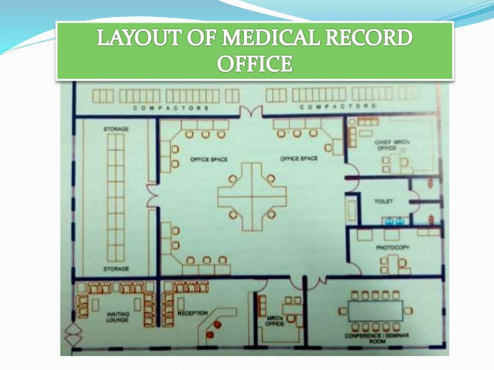

Slide 3
GOAL
To maintain a modern and scientific medical record system in conformity with international standards in all hospitals.
To ensure that medical records contain comprehensive and accurate social , medical, and vital information which will facilitate the provision of effective medical services.

Slide 4
OBJECTIVES (FUNCTIONS)
1. To initiate process, and check the patient records from inpatient, outpatient and emergency services to ensure that all the necessary forms and information are available.
2. To cooperate with the medical, nursing, and other healthcare professionals in order to obtain comprehensive patient records and to design and develop effective medical record forms.
3.To assemble medical records in accordance with the prescribed standard order.
4.To code and index medical records as per international classifications of diseases and operations.

Slide 5
OBJECTIVES (FUNCTIONS)
5. To maintain and preserve patient records including X-rays and diagnostic reports in a scientific way for the period recommended in the “retention schedule”.
6.To retrieve medical records to meet the needs of patient care, medical education , medical training , medical research, medicolegal problems , and the evaluation of patient care.
7.To provide and maintain a system for transcription of selected medical reports.
8. To control movement of patient files in order to achieve a unit record system, to protect files from unauthorized disclosure,to ensure confidentiality for the legal interests of i.e. patient, the hospital , and the physician through proper custody of the records.

Slide 6
OBJECTIVES (FUNCTIONS)
9. To participate and co-operate with committees such as medical records , quality assurance, infection control, administrative , financial and other committees.
10.To carry out the work of central registration for initiating new patient records including the patient master index .
11. To schedule and register follow-up appointment cases and referral cases in the outpatient department .
12. To register and maintain records for emergency cases including medico logical cases in the accident and emergency department .
13. To carry out admitting procedures for patients requiring hospitalization.

Slide 7
OBJECTIVES (FUNCTIONS)
14. To coordinate with other services related to those of the medical record department for effective filing and retrieval of patient records.
15. To prepare and complete procedures related to medical reports, certificates, and birth and death reports, and to submit data to appropriate authorities.
16. To register admitted and discharged cases in the ward register, schedule appointments for follow –up cases and to carry out the related ward clerk duties.
17. To receive and preserve the patient’s property in the admissions office in the absence of relatives who assume responsibilities.

Slide 8
ORGANIZATION & FUNCTIONS
The function of MRD Classified into the four following different categories :
Outpatient
Accident and emergency (casuality ) service
Inpatient
Medical record library

Slide 9
OUTPATIENT SERVICE
The OPD medical record services are classified into two section :
A. Central registration and appointment
This section functions around the clock throughout the year with three shifts
Function of the personnel employed should be :
Control of hospital numbers
Preparation of prenumbered folders
Registration of new cases
Maintenance of patient master index
Registration of follow up appointment cases
Supply of records to outpatient clinics

Slide 10
OUTPATIENT SERVICE
B. Out patient Clinic
The medical record staff posted in this unit perform the following functions:
Collection of new and followup registered patient records including X –rays .
Maintenance of accounts of patients treated in the clinic
Maintenance of accounts of patients referred to and received from other clinics, investigations, and admissions .
Collection and return of records to the medical record files

Slide 11
ACCIDENT AND EMERGENCY SERVICE
This unit functions around the clock throughout the year with three shifts
The personnel employed in this service perform the following functions :
Control of causality numbers
Preparation of prenumbered folders
Registration of causality cases.
Referral of patients for follow-up appointments, admissions and so on
Registration of medicolegal cases
Collection and mounting of investigation reports
Collection of statistics and filling of A/E records

Slide 12
INPATIENT SERVICE
The inpatient medical record services are classified into two sections:
A. Admissions Office :
This office functions around the clock through out the year.
Staff are posted in three shifts to perform the following functions.(In small hospitals, the work of the third shift can be transferred to causality section )
Maintenance of waiting list of patients
Registration of admissions and discharges
Maintenance of bed occupancy board
Secures patient property.

Slide 13
INPATIENT SERVICE
B. Ward :
Thev work relating to medical records in the ward will be performed by ward nurse, or ward clerk(AMRT)
The following are the main functions:
Registration of admissions and discharges
Receipt and mounting of investigation reports in the appropriate records
Maintenance of accounts of bed position
Scheduling of appointments for follow-up cases
Preparation and submission of ward daily census reports.

Slide 14
MEDICAL RECORD LIBRARY
The medical record library (especially the filling and retrieving units )function around the clock. The staff are posted on three shifts and broadly perform the following function :
Processing of outpatient records.
Processing of inpatient records
Collection and analysis of hospital statistics
Filing and retrieval of records and X-rays
Performance of general medical record function

Slide 15
1.Processing of Outpatient Records
Receipt of records from outpatient clinics and arrangement of these records in a prescribed standard order
Receipt and mounting of investigation reports in appropriate
Checking for deficiencies in partient records

Slide 16
2. Processing of Inpatient Records
The main functions of this unit as follows :
Collection and checking of daily ward census reports along with the discharged patient records and collection of late investigation reports
Analysis of discharged patient records
Assembly of records in a prescribed standard order and checking for deficiencies .
Coding and indexing of completed records as per the latest revision of ICD .

Slide 17
3.COLLECTION AND ANALYSIS OF HOSPITAL STATISTICS
The main function of this unit is to collect statistics of outpatient, accident and emergency , inpatient, and administrative statistics , to analyse these statistics, and to prepares reports on a daily, monthly, and yearly basis.

Slide 18
FILLING AND RETRIEVAL OF RECORDS AND X RAYS
This unit works around the clock, throughout the year, with three shifts .
Main function of this unit:
Collect records, X RAYS ,
Arrange them in a required order prior to filling them.
The patient records and X rays are filed according to terminal digit filing .
They also retrieves records and X rays for patient care, medical education, medical research, as well as other administrative purposes.

Slide 19
FILING SYSTEM
There are 3 different types of filing system.
Straight Numeric Filing Method
Terminal Digit Filing Method
Middle Digit Filing Method

Slide 20
STRAIGHT NUMERIC FILLING METHOD
All records should be filed in the strict numerical order.
Easiest methods of filing system.
DISADVANTAGES:
Mis filed records will consumes lot of time
The records will be added to one end of the filing rack .by which the equal distribution of work will be difficult.

Slide 21
TERMINAL DIGIT FILING METHOD
Terminal digit filing is a simple and accurate filing method which increases productivity of file clerks.
Usually a six –digit number is used and divided with a hyphen into three parts, each part normally containing two digits.
The primary digits are the last two digits on the right hand side of the number .
The secondary digits are the middle two, and the tertiary digits are the first two on the left side of the number.
In terminal digit file, there are 100 primary selections, ranging from 00to 99.
When filing, a clerk considers the primary digits first, taking the record to the corresponding primary section.
Within each primary section, groups of records are matched according to secondary digits.
After locating the correct secondary digit section, the clerk files in numerical order by terminal digits.

Slide 22
In the file, the second tertiary digit changes with every record. NOTE Following sequence :
56-46-96 98-46-96 98-99-96
57-46-96 99-46-96 99-99-96
58-46-96 00-47-96 00-00-97
ADVANTAGES :
As new records are added to file, their terminal digit numbers are equally distributed throughout the 100 primary sections .
Only every 100th new medical record will be filled in the same primary section of the file. The implications of the ‘perfect’ distribution are extensive.
The congestion that results when several clerks file active records in the same area of the file is eliminated.
Clerks may be assigned responsibility of certain sections of file.
As the registration numbers are still assigned in straight numerical order, the work is evenly distributed with each clerk having approximately the same number of active records in each section.
Inactive records may be pulled from each terminal digit section as new records are added.
Mis files are substantially reduced with the use of terminal digit filing. Since the clerk is concerned with only one pair of digits at a time, the transposition of numbers is less likely to occur .

Slide 23
MIDDLE DIGIT FILLING METHOD
The clerk files according to pairs of digits as in the terminal digit method.
The Primary, Secondary and tertiary digits are in different positions .
The middle pair of digits in a six –digit number are the primary digits the digits on the left are secondary digits, and the digits on the right are tertiary digits.
46 88 86
Secondary primary tertiary
NOTE: Sample sequences from middle digit file :
46-68-96 99-68-96
46-68-97 99-68-97
46-68-98 99-68-98
46-68-99 99-68-99
47-68-00 00-69-00
47-68-01 00-69-01
47-68-02 00-69-02

Slide 24
MIDDLE DIGIT FILLING METHOD
ADVANTAGES:
1. Simple to pull up to 100 consecutively numbered charts for study purposes.
2. Conversion from a straight numerical system to a middle digit system is much simpler than conversion to a terminal digit system.
3Middle digit filing provides a more even distribution of records than straight numerical filing, although it does not equal the balance achieved by a terminal digit filing system .
4. Clerk may be assignmed responsibility for certain middle digit sections.As in terminal digit filing, the clerk is filing by pairs of digits rather than six or seven digits , therefore mis files are reduced .

Slide 25
COLOR CODING OF THE RECORD FOLDERS
It refers to the use of colour on folders to aid in the preventions of mis files and in the location of mis-filed records.
Colour bars in various positions around the edges of folders ( known as blocking )create distinct patterns of colours in various sections of the file.
A Break in the colour pattern in a file section signals a misfiled record.
Colour coding is most effective when used in conjunction with terminal digit and middle digit filing, although workable colour –coding systems can be used for straight numerical filing .
One approach to colour-coding in a terminal digit or middle digit file utilizes then different colours to signify the first primary digits 0 to 9.
Two colour bars or blocks appearing in the same position can be used to signify each of the two primary digits
In this case the top colour bar represents the left hand digit of the primary set, and the bottom colour bar represents the right hand digit of the primary set.
If brown is the colour assigned to the digit 8 and green is the colour assigned to the digit 4, a chart numbered 1694 84 in a terminal digit file is colur with a brown band on top, with green band directly beneath it .

Slide 26
ORGANIZATIONAL CHART OF MRD STAFF
MEDICAL RECORD OFFICER
ASST. MRO
ASST.MRO
MRT
MRT
MRT
MRT
WARD
MED.SEC
MRT
GENERAL
OUTPATIENT
MRT
STATISTICS
A/E
ADM
Proc. Of IP Rec
Filling Rec/ X ray
Retriev-Rec/X ray
Proc.of OP. Rec
CR and Appoint
OP Clinic

Slide 27
NORMS FOR DEVELOPING THE NUMBERS OF PERSONNEL
FORMULA for deploying the number of personnel to furnish around the clock service :
Working day x number of shift =numbers of persons required to be posted
Man days
Eg. 365x3 =5 approx.
217
Man days are actual working days available
Like after subtrating the number of holidays to which the staff is entitled.

Slide 28
FORMULA FOR DEVELOPING THE NUMBERS OF PERSONNEL
A minimum of two persons for any size of the hospital +1 persons for every 100 beds (50-100) +1 persons for every 10 beds
Numbers of staff required for MRD
100 Beded hospital :2+1+10=13 personnel
500 Beded Hospital hospital : 2+5+50= 57 personnel

Slide 29
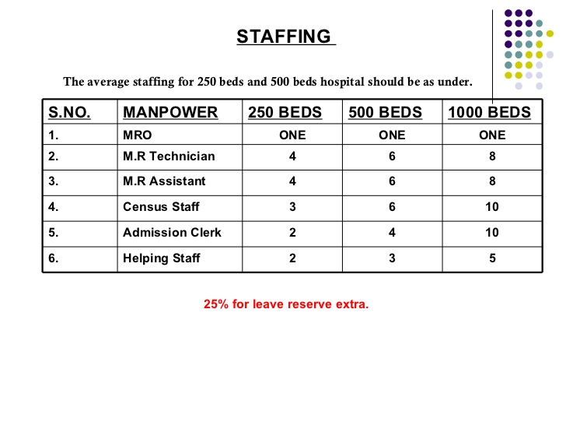
STAFFING

Slide 30
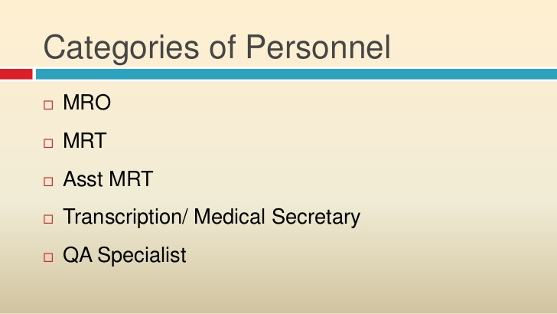

Slide 31
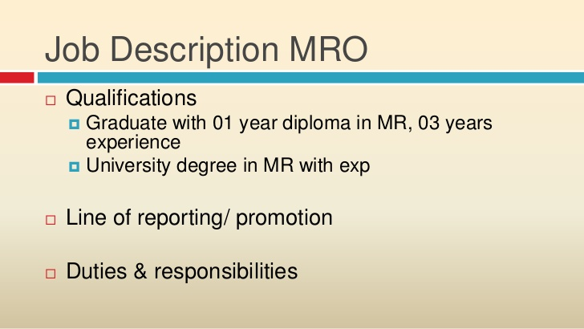

Slide 32
DUTIES AND RESPONSIBILITIES OF MRO
To establish , organize, and manage a MRD of a hospital in a effective way .
Development of polices and procedures as per HEALTH DIRECTORATE/ MINISTRY OF HEALTH .
Assist medical record committee for developing different forms.
Review of Medical Records of different department
Cooperate with other department’s staffs .
To participate and assist in quality assurance , utilization review, infection control and other committees.
Prepare all medical reports medical certificate, birth / death register and notify concerned authorities.
Prepare monthly statistical reports concerning the hospital activities carried out .
Observe professional ethics and to protect the confidentiality of information.
Participate and assist in research programme .
Select appropriate personnel for MRD.
Prepare educational training programs

Slide 33
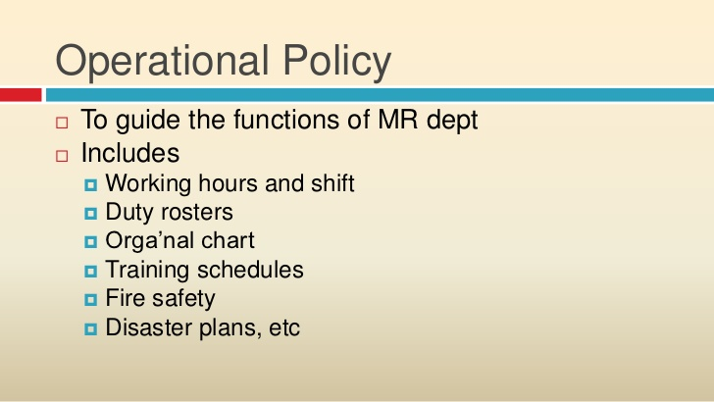

Slide 34
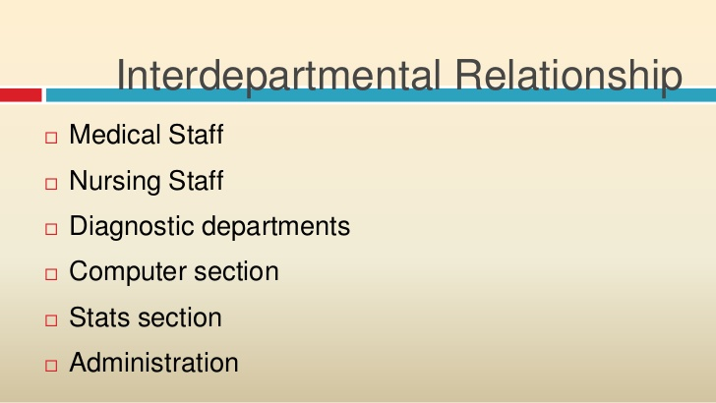
A/E
MEDICAL
PARAMEDICAL
COMPUTER
ADMINISTRATION
ADMISSION
NURSING
INVESTIGATION
STATISTICS
OTHERS
OPD
MRD
WARD

Slide 35
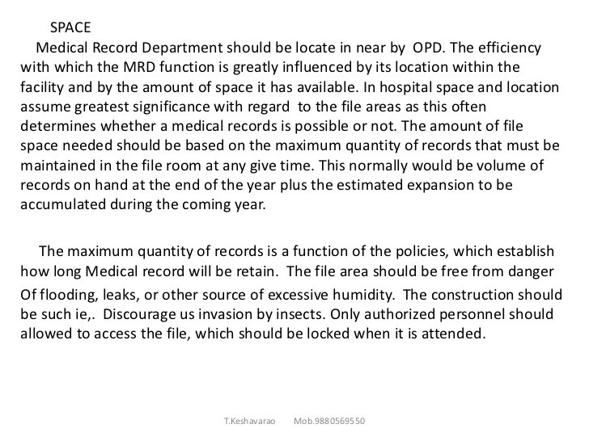

Slide 36
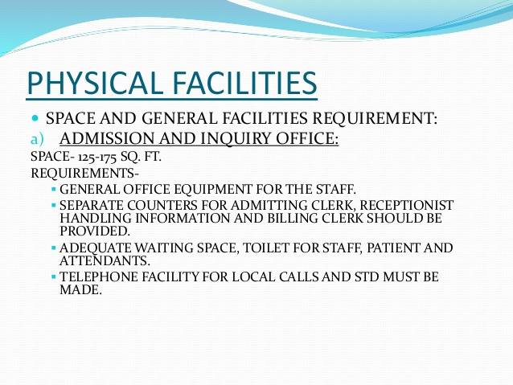

Slide 37
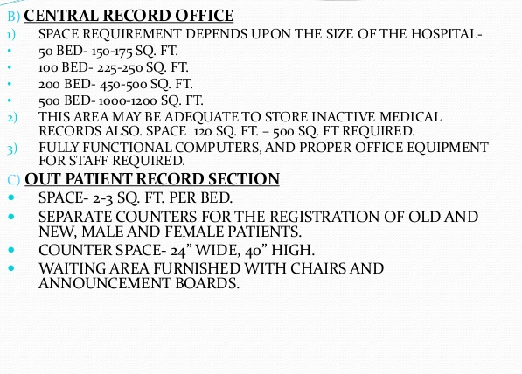

Slide 38
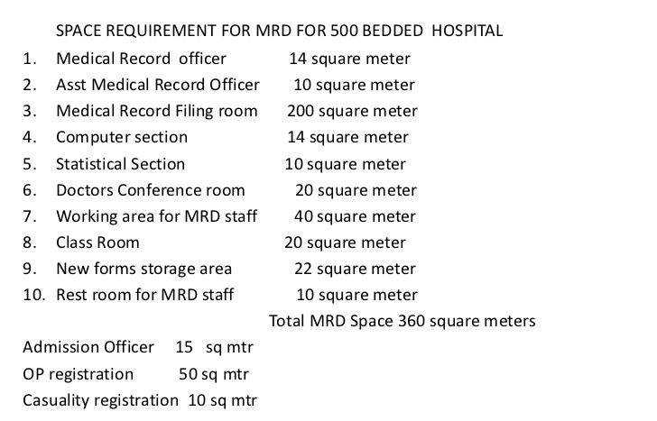

Slide 39
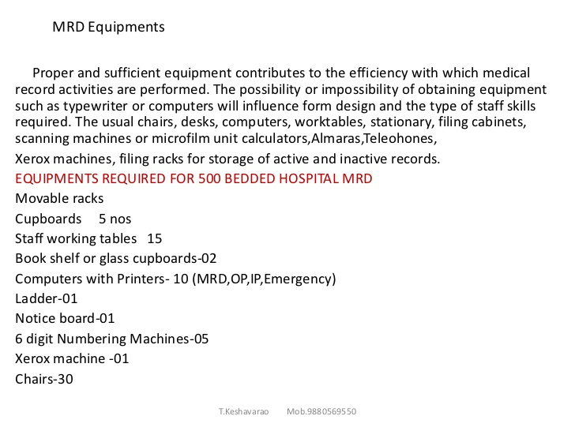

Slide 40
